Slide 1
ARMing-sword: Scabbard on ARM
HyeokDong Kwon¹, Hyunjun Kim¹, Minjoo Sim¹, Siwoo Eum¹, Minwoo Lee¹, Wai-Kong Lee², and Hwajeong Seo¹
¹Hansung University, ²Gachon University
22. 08. 24.
Notes:
Hello everyone, I’m hyeokdong kwon from hansung university.
I prepared presentation about ARMing-sword that efficient implementation of Scabbard cryptography on ARM processors.
let’s get started

Slide 2
Introduction
Backgrounds
ARMing-sword
Evaluation
Conclusion
Notes:
The contents of this presentation is as follows.
First is introduction, second is background I will talk about Saber, Scabbard and ARM processors.
Third is proposed implementation ARMing-sword,
Fourth is evaluation our implementation, and the last is conclusion.

Slide 3
Introduction
With the development of quantum computers, classic cryptography algorithms are threatened. (e.g. RSA, ECC)
In preparation for the quantum computer era, the Post-quantum cryptography (PQC) became necessary.
The Scabbard is one of the PQC.
Originated from Saber.
Round 3 candidate of Public-key Encryption.
In this paper, we proposed ARMing-sword.
Optimized implementation of Scabbard.
Notes:
The post-quantum cryptogrphy is very important that classic cryptography algorithms are threatened by quantum computers.
So NIST held the post-quantum cryptography standardization competition, and Saber is one of Round 3 candidate of Public-key Encryption.
And Scabbard is improved version of Saber cryptography.
In this time, we present ARMing-sword that optimized version of Scabbard on ARM processors.

Slide 4
Introduction
Our main contributions
Step-by-step optimization of multiplier.
Scabbard multiplier consists of three steps: Evaluation, Multiplication, Interpolation.
We focused on Evaluation and Multiplication steps.
Implemented with revised internal structure and using parallel operations.
Customized optimized implementation for each scheme.
Scabbard has three schemes: Florete, Espada, Sable.
Each scheme has different structure, so our approaches also applied in various ways.
The first implementation of Scabbard on the ARMv8 processors.
It might be helpful to following researchers.
Notes:
Our contributions is as follows.
First, step-by-step optimization of multiplier.
Out target algorithm Scabbard using multiplier that consists of three steps: Evaluation, Multiplication, Interpolation.
We focused on Evaluation step and Multiplication steps.
Mainly, we revised internal structure of Evaluation and Multiplication steps. Also, we applied parallel operations to fast computation.
Second, we propose customized optimized implementation technique for each scheme.
The Scabbard cryptography has 3 shcemes that named Florete, Espada, and Sable.
Each scheme has different structure, so we need to customized implementation to efficient implementation.
Third, the first implementation of Scabbard on ARMv8 processors.
It might be helpful to following researchers.

Slide 5

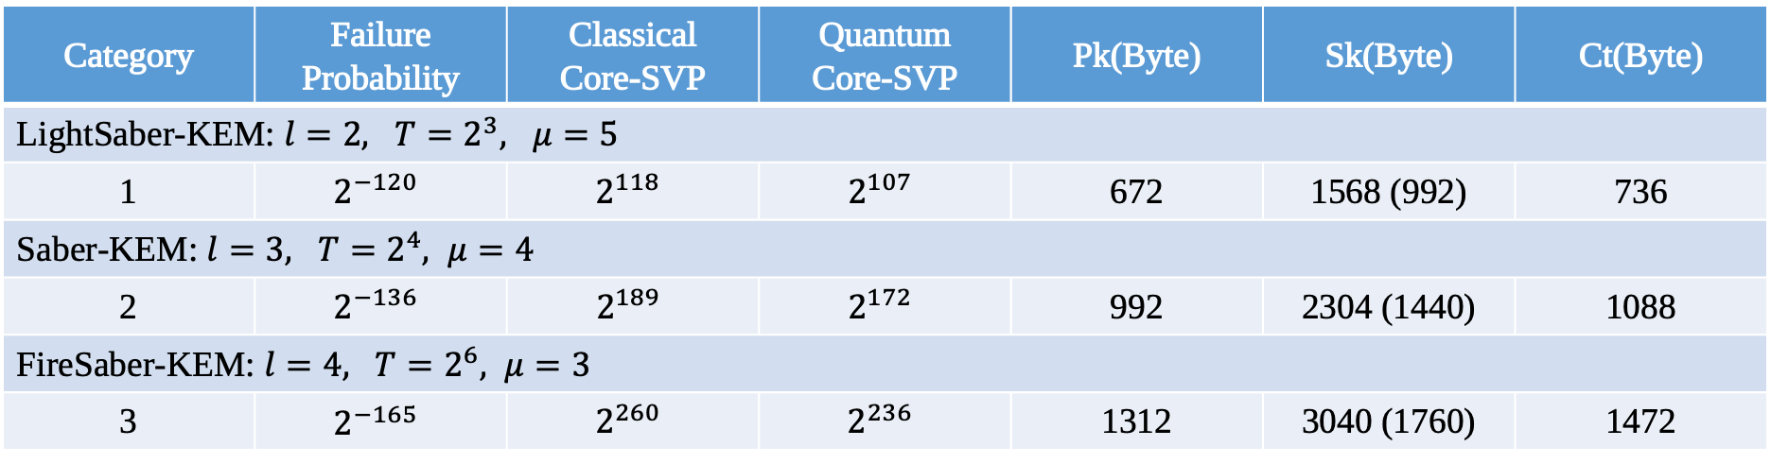
Background: Saber and Scabbard
Lattice-based cryptography.
Round 3 candidate of NIST PQC standardization for KEM.
Other candidates: Classic McEliece, CRYSTALS-Kyber, NTRU.
Failed to advance to Round 4.
Common parameters: $q=2^{13}, p=2^{10}, f(x)=x^{256}+1$
Category | Failure Probability | Classical Core-SVP | Quantum Core-SVP | Pk(Byte) | Sk(Byte) | Ct(Byte)
LightSaber-KEM: $l=2, T=2^{3}, μ=5$
1 | $$2^{−120}$$ | $$2^{118}$$ | $$2^{107}$$ | 672 | 1568 (992) | 736
Saber-KEM: $l=3, T=2^{4}, μ=4$
2 | $$2^{−136}$$ | $$2^{189}$$ | $$2^{172}$$ | 992 | 2304 (1440) | 1088
FireSaber-KEM: $l=4, T=2^{6}, μ=3$
3 | $$2^{−165}$$ | $$2^{260}$$ | $$2^{236}$$ | 1312 | 3040 (1760) | 1472
Notes:
The Saber is Round 3 candidate of NIST PQC standardization.
It is lattice-based cryptography, and the name is derived from one of a sword.
The Saber is candidate of key encapsulation mechanism, but failed to advance to Round 4.
Below the table shows that parameters of Saber.

Slide 6
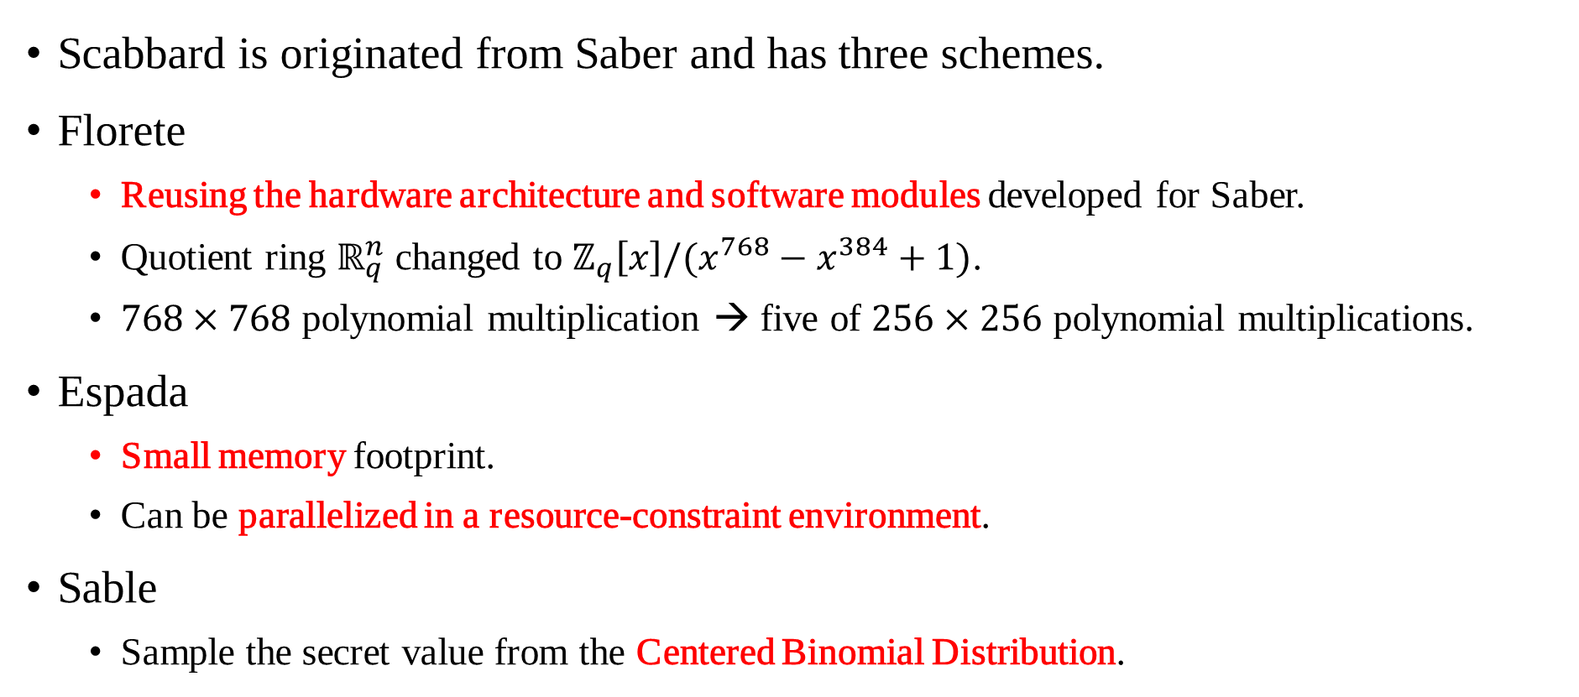
Background: Saber and Scabbard
Scabbard is originated from Saber and has three schemes.
Florete
Reusing the hardware architecture and software modules developed for Saber.
Quotient ring $ℝ_{q}^{n}$ changed to $ℤ_{q}\left[x\right]/(x^{768}−x^{384}+1)$.
$768×768$ polynomial multiplication → five of $256×256$ polynomial multiplications.
Espada
Small memory footprint.
Can be parallelized in a resource-constraint environment.
Sable
Sample the secret value from the Centered Binomial Distribution.
Notes:
The Scabbard is alternate version of Saber cryptography.
It has three kinds of scheme.
The first is Florete, it focused on reusing the hardware architecture and software modules of Saber.
Also, it lowered the number of digits of multiplication, it has little bit faster than before multiplication.
The second is Espada. Its approach is ‘to get small memory consumption’.
And it can be parallelized in limited environment, such as microcontrollers.
The last one is Sable, it using Centered Binomial Distributions.

Slide 7
Background: Apple M1 processor
One of the ARMv8 processor.
64-bit general purpose registers, 128-bit vector registers.
Vector registers can be calculated values in parallel.
Internal values treated in different units depending on the arrangement specifier.
8-bit(8b, 16b), 16-bit(4h, 8h), 32-bit(2s, 4s), 64-bit(1d, 2d).
Arrangement specifiers belong to instructions.
Operational units can be changed by specifiers of instructions.
v_{n}.16b
v_{m}.16b
v_{o}.16b
Notes:
The target processor is 64-bit ARMv8 processor.
It has 4-bit general purpose registers, and 128-bit vector registers.
Among them, the vector registers can be operated in parallel way with vector instructions.
The maximum size of vector register is 128-bit, but internal values are treated by arrangement specifier.
For example, ‘b’ specifier means ‘byte’, so internal values are treated as 8-bit. In this case, it can be stored 16 in maximum.
The arrangement specifiers are belonging to instructions, so internal unit of vector registers can be changed anytime.
When using vector instructions, every operation are working in parallel like figure.
In the example, you can see that 16 bytes are added in parallel.

Slide 8
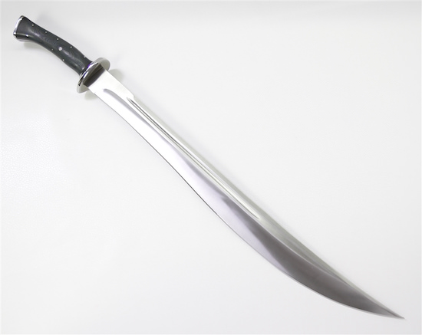
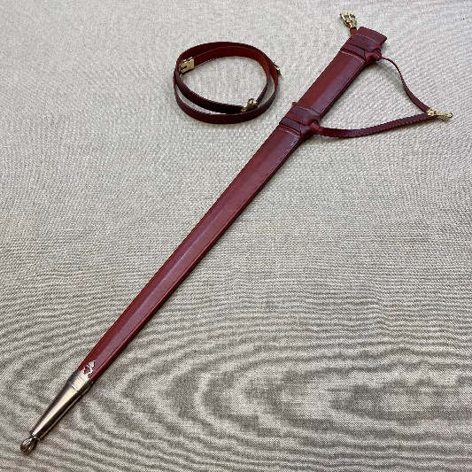
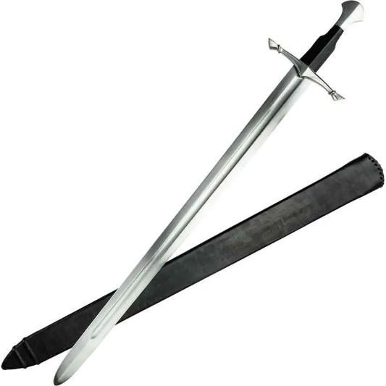
ARMing-sword
We propose ARMing-sword.
Optimized implementation of Scabbard on ARM processors.
Two kinds of optimization techniques.
Evaluation step: Direct Mapping.
Multiplication step: Sliding Window.
Saber
Scabbard
ARMing-sword
Notes:
So we implemented ARMing-sword.
It is optimized implementation of Scabbard on the ARM processors.
We proposed two kinds of optimization techniques, Direct Mapping and Sliding Window.

Slide 9
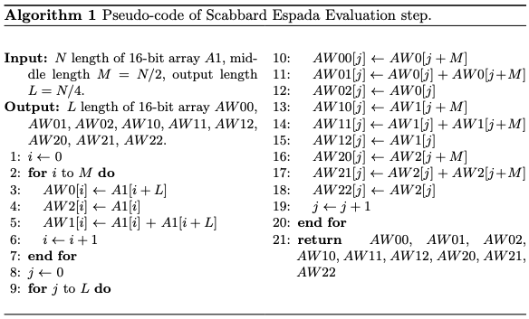
ARMing-sword
In the Evaluation stage
All of input arrays are traversed and stored in different variables.
N length of 16-bit array → N/4 length of 16-bit arrays of 9.
It takes very long time.
Is there any additional method besides parallelization?
Notes:
In the Evaluation step, the array shape is transformed to change the input array into a shape suitable for operation.
The result of this step, N length of 16-bit array is changed to 9 of N/4(quarter) length of 16-bit arrays.
This step is performed at the start of multiplication, and the computational load is high because the size of the array is large to iterate through all the arrays.
The problem can be easily solved by using parallelization, but we thought about a way to get more performance.

Slide 10
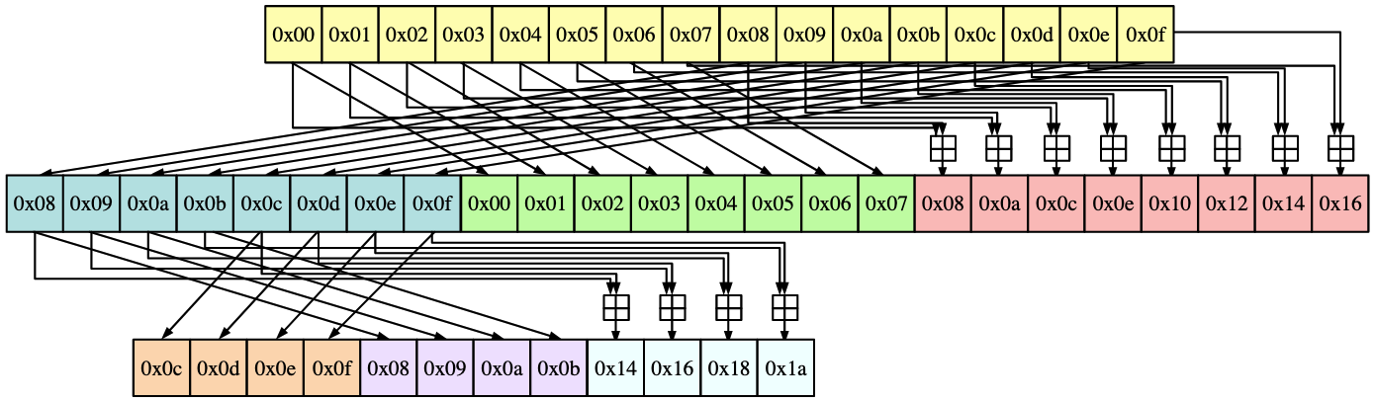
ARMing-sword
Evaluation consists of three stage.
N length of 1 → N/2 length of 3 → N/4 length of 9
At each step, half of the array is moved to the same way.
Each variable moves in two places.
Notes:
The Evaluation step is consisted with three stage.
When an input array of length N is initially entered, it becomes an array of three N/2 lengths. The next step is an array of 9 N/4 lengths.
The figure shows movements of array elementals.
As we can see, half of array is moved to the same direction and moves in two registers.
In this figure, half of first 8 values are going to first part and third part of next stage..
Also, first part of second stage, 4 values are going to first part and third part of last stage.
Here you can see that the first 4 values of the last stage are derived from the last 4 values of the first stage.

Slide 11
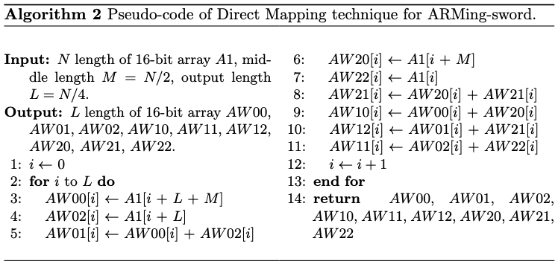
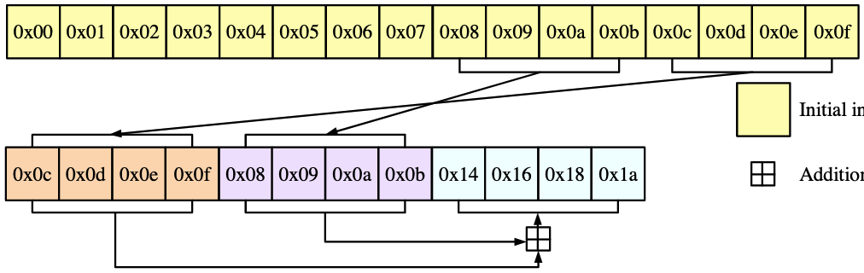
ARMing-sword
Revised structure of Evaluation step. → Direct Mapping.
To generate result values directly.
Move multiple variables at once using vector instructions.
It can be reduced number of variables move and calculation.
Notes:
So we revised Evaluation step structure, and named it Direct Mapping.
This structure generate the result value in two steps.
The implementation also uses vector instructions to move multiple values at once to speed up the operation.

Slide 12
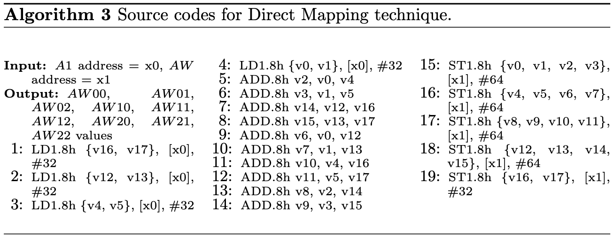
ARMing-sword
Implementation codes for Direct Mapping technique.
Written by ARM assembly.
Notes:
This is source code of out implementation.
Line 1-4, load initial input array.
At this moment, some values does not need additional operations.
So these values are loaded into vector registers to be used for output. It can be checked to line 1 and 2.
Line 5-6, calculating third part of last stage, and line 7-8 calculating nineth part of last stage.
In line 9-14, calculating fourth to sixth part of last stage, it seems to be more complicated than other parts.
It because these values are derived from first three values and last three values of result array.
Line 15-19, Save the rest of the operation result.

Slide 13
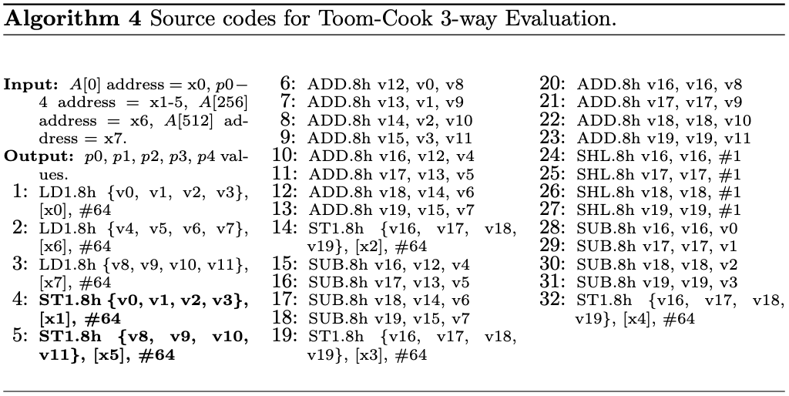
ARMing-sword
Toom-Cook 3-way with Direct Mapping.
Multiplication source codes are based on Scabbard.
Toom-Cook 4-way also can be implemented same method.
Notes:
In the case of Florete and Sable, it is implemented according to Toom-Cook 3-way or 4-way.
So implementation codes is some different but basic approach is same that before.

Slide 14
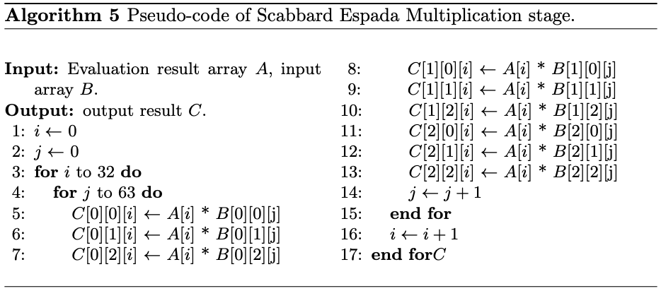
ARMing-sword
In the multiplication stage.
It implemented as a nested loop.
The indexes are moved to 16-bit units.
However vector instructions only can be moved pointer to 32-byte or 64-byte units.
Notes:
After Evaluation step, the multiplier enter to the Multiplication step.
The Multiplication stage implemented with nested loop.
All of array values 16-bit units, and it can be easily implemented when using C language.
When using the C language, it is possible to simply add 1 to the index variable to increase the array index.
However, vector instructions only can be moved index pointer to 32-byte or 64-byte units.

Slide 15
ARMing-sword
We using general register to pointer. → Sliding Window.
Calculate by calling the values at the point currently pointed to by the pointer.
When the calculation is finished, the value is stored in the memory of that pointer.
Move a pointer to calculate the next value.
Values of multiplication step can be accumulated in this way.
Initial pointer
Initial position of window
Moved pointer
At the end of calculation, pointer moved to next array.
Moved position of window
Notes:
So we using general register to pointer and named sliding window.
Every calculation is performed to loaded values at current pointer by vector instructions,
and when the calculation is finished, the result values are stored to current pointer position.
After that, move a pointer to calculate the next value, and loaded values to calculate by vector instructions.
With this method, 1 general register used for pointer, and it is look like something window.
And it moves to next position until end of calculation.

Slide 16
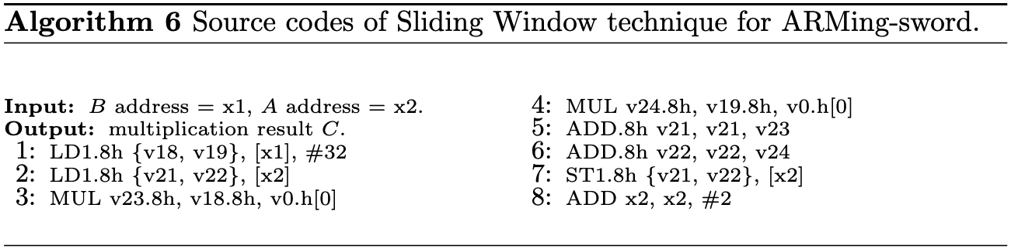
ARMing-sword
Implementation codes for Sliding Window technique.
Written by ARM assembly.
Notes:
It is implementation codes for Sliding Window.
Line 1-2, loading parameters.
Line 3-4, calculating multiplication process.
Line 5-7, accumulating the result values to current pointer.
Lint 8, window will be slide to next value.

Slide 17
Evaluation
Target processor: Apple M1 processor (@3.2GHz).
Framework: Xcode IDE.
Language: Objective-C, C, ARM assembly.
Compare with previous reference C implementation.
Scabbard open source C code used.
Compiled with –O3 option (fastest).
Two kinds of result.
Multiplier: average time of 1,000,000 iterations.
Scabbard and ARMing-sword: average time of 10,000 iterations.
Notes:
Now we evaluate proposed implementation.
The target processor is Apple M1 processor, is one of Arm family.
We compare previous C implementation from distributed Scabbard library.
It is written by C language, but it ported to work on target processor.
The results is two tracks.
First is Multiplier, we derived evaluation results through average execution time of 1,000,000(million) iterations.
Second is Scabbard and ARMing-sword, in this case each algorithms are iterated 10,000(10 thousand) times.

Slide 18
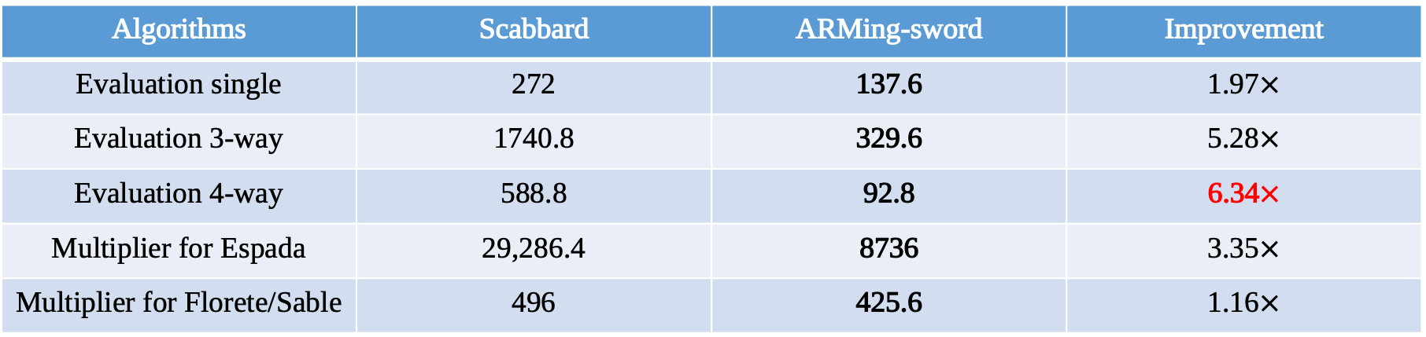
Evaluation
Multiplier results (Unit: clock cycles).
Performance gap 6.34 when best case.
Multiplier of ARMing-sword Espada shows effective then Scabbard.
Multiplier of ARMing-sword Florete and Sable has similar performances with Scabbard.
Algorithms | Scabbard | ARMing-sword | Improvement
Evaluation single | 272 | 137.6 | 1.97$×$
Evaluation 3-way | 1740.8 | 329.6 | 5.28$×$
Evaluation 4-way | 588.8 | 92.8 | 6.34$×$
Multiplier for Espada | 29,286.4 | 8736 | 3.35$×$
Multiplier for Florete/Sable | 496 | 425.6 | 1.16$×$
Notes:
In case of multiplier, proposed multiplier of ARMing-sword has 6.34 better performance when best case.
The multiplier of ARMing-sword Espada is very effective then Scabbard multiplier.

Slide 19

Evaluation
Result of cryptography algorithm (Unit: $×{10}^{4}$clock cycles).
In almost all cases, ARMing-sword has better performance than Scabbard.
In case of Espada shows best improvement.
Scheme | Algorithm | Scabbard | ARMing-sword
Sable | KeyGeneration | 80.8 | 75.7
 | Encapsulation | 89.8 | 84.1
 | Decapsulation | 93.4 | 88.4
 | All | 263.2 | 247.5
Espada | KeyGeneration | 475.6 | 230.7
 | Encapsulation | 505.4 | 239.7
 | Decapsulation | 521.2 | 241.7
 | All | 1497.4 | 720.4
Florete | KeyGeneration | 53.2 | 50.8
 | Encapsulation | 72.5 | 72.6
 | Decapsulation | 86.0 | 78.9
 | All | 222.1 | 203.8
Notes:
And the result of cryptography algorithms, almost cases ARMing-sword has better performance than scabbard.
Multiplier of Espada performed the best, so the ARMing-sword Espada algorithm showed the best performance.

Slide 20
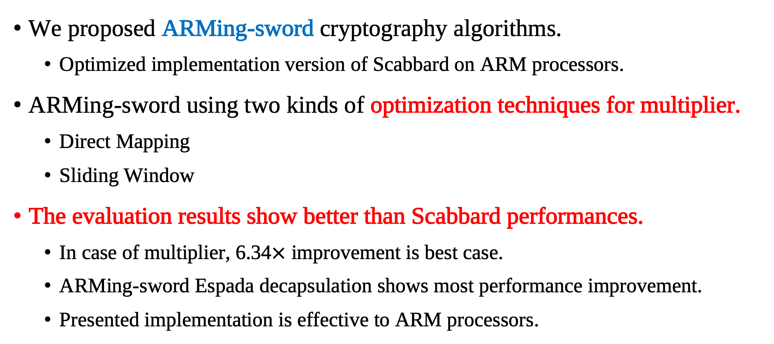
Conclusion
We proposed ARMing-sword cryptography algorithms.
Optimized implementation version of Scabbard on ARM processors.
ARMing-sword using two kinds of optimization techniques for multiplier.
Direct Mapping
Sliding Window
The evaluation results show better than Scabbard performances.
In case of multiplier, 6.34$×$ improvement is best case.
ARMing-sword Espada decapsulation shows most performance improvement.
Presented implementation is effective to ARM processors.
Notes:
This is last slide of this presentation.
We implemented optimized version of Scabbard that named ARMing-sword on ARM processor.
ARMing-sword using two optimization techniques for multiplier which are Direct Mapping, and Sliding Window.
The evaluation results show better than Scabbard performances.
In case of multiplier, the best case is 6.34 times improvement.
And ARMing-sword Espada decapsulation shows most performance improvement.
Finally, our presented implementation is very effiective to ARM processors.

